Slide 1
Composite Event Detection in WSN
Steven Lai

Slide 2
Motivation
WSNs are closely integrated with physical world
Most of the WSN applications are event-oriented:
Event monitoring
Event detection
Event notification
Existing works on middleware for WSN are not suitable for such kind of application model.
Composite event-based pub/sub middleware seems to be more suitable.
My previous work on composite event detection is based on static events and we can extend that work to dynamic events as well.

Slide 3
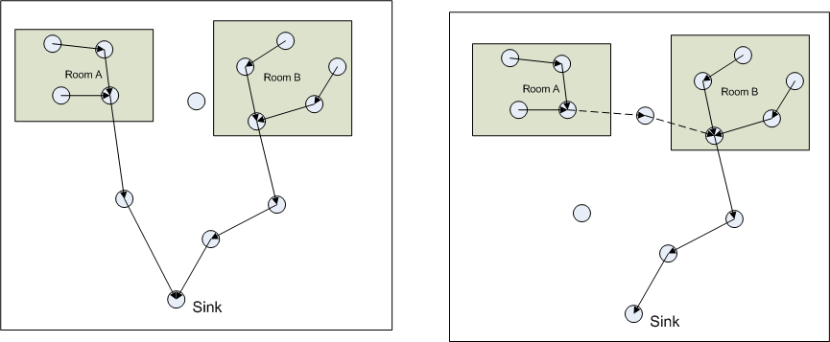
Static Events

Slide 4
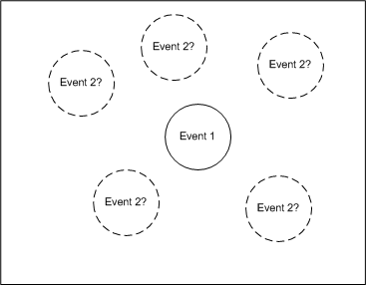
Dynamic Events

Slide 5
Example of Dynamic Events
Event {
} on {
LightEvent e1, SoundEvent e2;
} where {
e1.x==3 and e1.y==4 and
e2.x-e1.x<2 and e2.y-e1.y<3
}

Slide 6
Issues in Detecting Dynamic Events
Event triggering / cancellation
Event detector selection
Wake-up scheduling
Energy balance

Slide 7
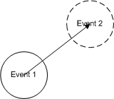
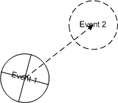
Event Monitoring – Triggering and Cancellation

Slide 8
Event Detector Selection

Slide 9
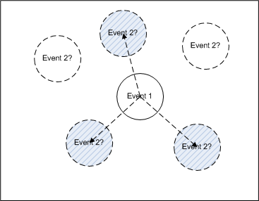
The Basic Idea

Slide 10
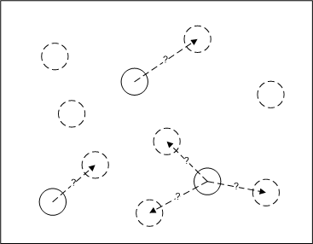
The Basic Idea Extended

Slide 11
System Model
Network Model
Event and Subscription Model
Cost Functions
Objective Functions

Slide 12
Network Model
Sensors are randomly deployed in an area.
One sink
All nodes are static
Mathematical representation: G=(V, E)

Slide 13
Event and Subscription Model
Event: a set of tuples containing (type, name, value)
Subscription: constraints on the attributes of the events
Subscription representation:
c_{p1}: f₁(e_{a1}, (e_{b1})) f₂(e_{a2}, (e_{b2})) … f_{n}(e_{an}, (e_{bm}))
c_{p2}: f₁(e_{a1}, (e_{b1})) f₂(e_{a2}, (e_{b2})) … f_{n}(e_{an}, (e_{bm}))
…
c_{pn}: f₁(e_{a1}, (e_{b1})) f₂(e_{a2}, (e_{b2})) … f_{n}(e_{an}, (e_{bm}))
Each f_{n} is a function on certain attributes with returning value of either true or false:
f _{attr}(e_{n}, e_{m}) = e_{n}.attr – e_{m}.attr op c
f_{attr}(e_{n}) = e_{n}.attr op c

Slide 14
Event and Subscription Model
Primitive Event:
e_{n}: f₁(e_{n}) f₂(e_{n}) … f_{m}(e_{n})
Composite Event:
We can find a row in all the event filters such that in this row ‘e_{c}: f₁(e₁, e₂) f₂(e₃, e₄) … f_{n}(e_{m-1}, e_{m})’ where there exists e_{c}!=e_{n} (e_{n} ∈ { e₁, e₂ … e_{m}})

Slide 15
Cost Functions
Cost for monitoring events:
No. of nodes participated (the area of the event based on our network model)
The rate of the event
c=e*r
Cost for delivering the event detection result:
Probability of the event that happens / not happens
The length of the delivery path
c=p*d

Slide 16
Problem Formulation (Event Cancellation)
Given:
Events being monitored: E={e₁, e₂, … e_{n}}
Rate of E: R={r₁, r₂, … r_{n}}
Events to be cancelled: E’={e’₁, e’₂, … e’_{m}}
Rate of E’: R’={r₁’, r₂’, … r_{m}’}
A set of edges: D={d₁, d₂, … d_{k}}. Each d_{k} connects e_{n} and e’_{m}

Slide 17
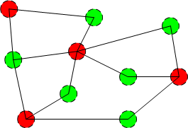
Problem Formulation (Event Cancellation)

Slide 18
Problem Formulation (Event Cancellation)
Cost functions:
Each event e_{n} has a cost: e_{n}*r_{n}
Each event e_{n}’ has a cost: e_{n}’*r_{n}’
Each edge d_{m} has a cost: d_{n}*e_{n}.r
When d_{n} is selected and it connects to e’_{m}, cost of e’_{m} is 0

Slide 19
Problem Formulation (Event Cancellation)
Objective:
Find: D’ ⊂ D
Minimize: C=∑((e_{n}+e_{n}.p*d_{n})*e_{n}.r+e’_{m}*e’_{m}.r)

Slide 20
Problem Formulation (Event Triggering)
Given:
Events being monitored: E={e₁, e₂, … e_{n}}
Rate of E: R={r₁, r₂, … r_{n}}
Events to be triggered: E’={e’₁, e’₂, … e’_{m}}
Rate of E’: R’={r₁’, r₂’, … r_{m}’}
A set of edges: D={d₁, d₂, … d_{k}}. Each d_{k} connects e_{n} and e’_{m}

Slide 21
Problem Formulation (Event Triggering)

Slide 22
Problem Formulation (Event Triggering)
Cost functions:
Each event e_{n} has a cost: e_{n}*r_{n}
Each event e_{n}’ has a cost: e_{n}’*r_{n}’
Each edge d_{m} has a cost: d_{n}*e_{n}.r
When d_{n} is selected and it connects to e’_{m}, cost of e’_{m} is e’_{m}

Slide 23
Problem Formulation (Event Triggering)
Objective:
Find: D’ ⊂ D
Minimize: C=∑((e_{n}+e_{n}.p*d_{n})*e_{n}.r+e’_{m}*e’_{m}.r)

Slide 24
Next Step
Find a distributed heuristic solution
Analyze the heuristic solution. Determine the lower-bound
Simulation to verify the analysis.

